Slide 1
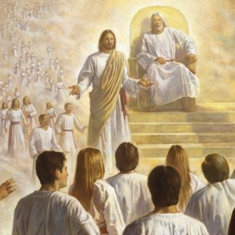
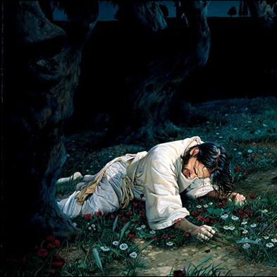
THE PLAN
OF SALVATION
THE ATONEMENT
OF JESUS CHRIST

Slide 2
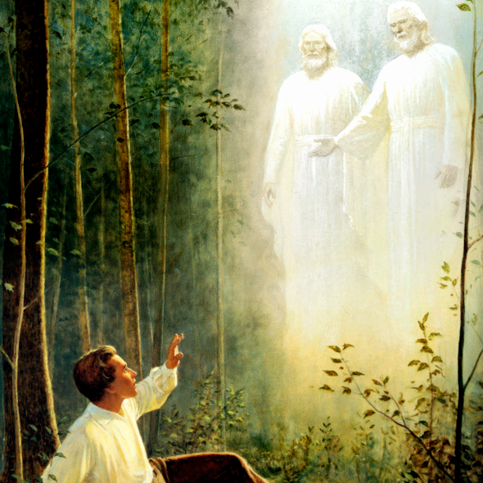
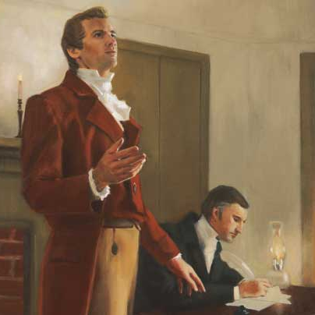
THE RESTORATION
PROPHETS AND REVELATION

Slide 3
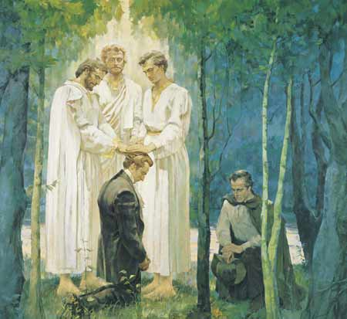
PRIESTHOOD AND PRIESTHOOD KEYS
ORDINANCES AND COVENANTS

Slide 4
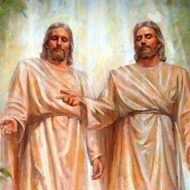
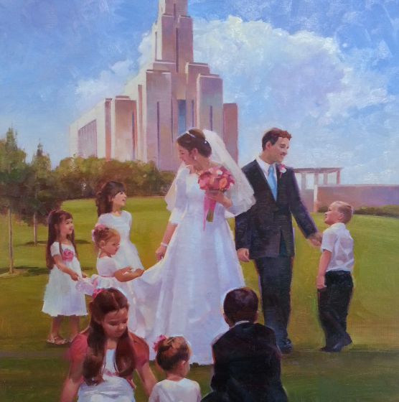
THE GODHEAD
MARRIAGE AND FAMILY

Slide 5
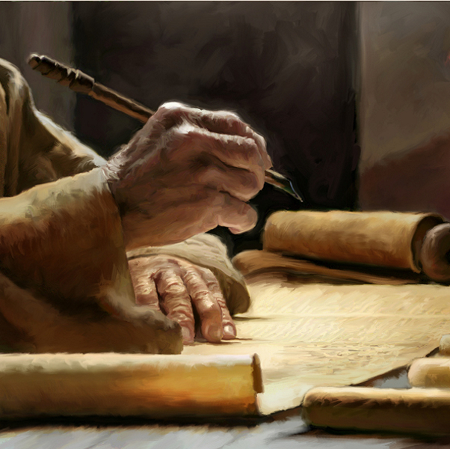
THE COMMANDMENTS
ACQUIRING SPIRITUAL KNOWLEGDE

Slide 6
Acquiring Spiritual Knowledge

Slide 7
Act in Faith

Slide 8
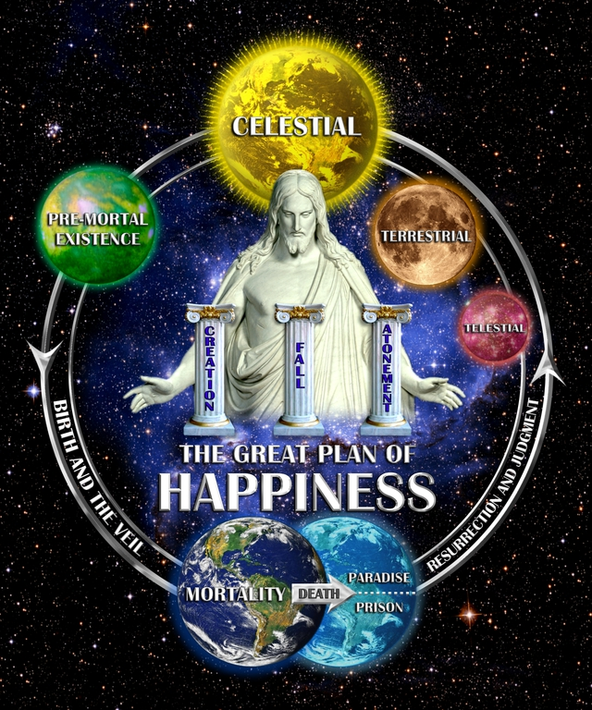
Examine with an Eternal Perspective
Concepts & Questions

Slide 9
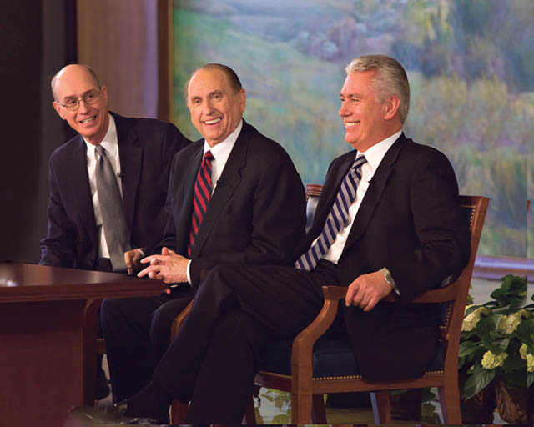
Understanding through Divinely Appointed Sources
Seek Further

Slide 10
“I have Learned for Myself that…”
JS-H 1:20

Slide 11
