Slide 1
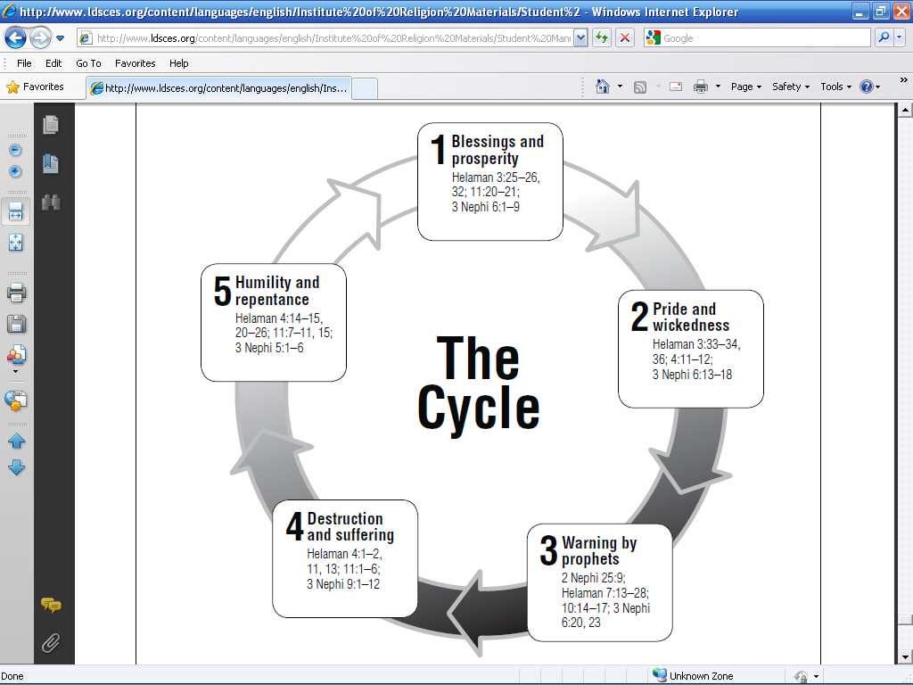

Slide 3
Humility & Repentance
Trials & Hard times

Slide 4
Pride & Wickedness
Blessings, Peace & Prosperity

Slide 5
Deliverance
Warnings by Prophets

