Slide 1
The Role of the Learner
Holy Spirit
Student
Teacher
Student
Notes:
This visual teaches the roll we all have to teach each other AND how it is critical never to get in the way of letting others be taught by the Spirit.

Slide 2
The One Rule In Seminary
Don’t do anything that might prevent the Spirit from being here -for yourself or anyone else.
Notes:
This is really the only rule I have as a teacher. To me, it is a principle that covers every possible rule like food, cell phones…

Slide 3

The
Notes:
At the end of class, I like to ask the class, or a particular student, what “The Take Away” was for that day. Sometimes I called this having a student “On the Spot” at the end of class . It is a great way to go over the 2-3 big takeaways from the lesson. If you don’t know what difference the lesson was supposed to make in their lives, they certainly won’t. And you won’t be able to testify of those things either.

Slide 4


The TakeAway
“I’m going to…”
Principles
“I know that …”
Doctrines
Notes:
Same as above. The “Take Away”s are usually principles or doctrines. In other words, they are actions you hope they make part of their lives, or they are beliefs you hope they come to know better.

Slide 5

Principles:
Say what we are to do
Use personal pronouns
Have a result
Examples of Principles:
“If I ... then…”
“We should… so that…”
“When we … then…”
“We need to… because…”
“I need to… so that…”
Doctrines
Say what we believe
Examples of Doctrines:
“I know that…
“I believe…”
Notes:
These are to help your students learn the difference between a principle and a doctrine. Take a block of scripture and have them pull out the principles by filling in the “. . .” in the graphic above.

Slide 6
Principles:
Have an action
Use personal pronouns
Have a result
Examples of Principles:
“If I ... then…”
“We should… so that…”
“When we … then…”
“We need to… because…”
“I need to… so that…”
Doctrines
Say what we believe
Examples of Doctrines:
“I know that…
“I believe…”
Notes:
This makes it easier on your printer

Slide 7

How to Give a Great Scriptural Thought
Feast
Find a scripture that has meaning for you and invite the class to turn to that scripture. Share the context of the verse(s).
Explain: Read the verse(s) and then explain what it means to
the class.
Apply: Tell what principle or doctrine you learned and how it
applies to everyone.
Share an experience that relates to the principle or doctrine
you learned.
Testify of the truths you found in the verses.
Notes:
I like to teach my class that Seminary is like a Pre-MTC and being able to give a scriptural thought is critical to missionary service so all year long, this is the way to give a proper scriptural thought. One day in class, I take a meaty chapter and divide it up and have individuals come up and share a scriptural through they found from their verses. Powerful lesson.

Slide 8
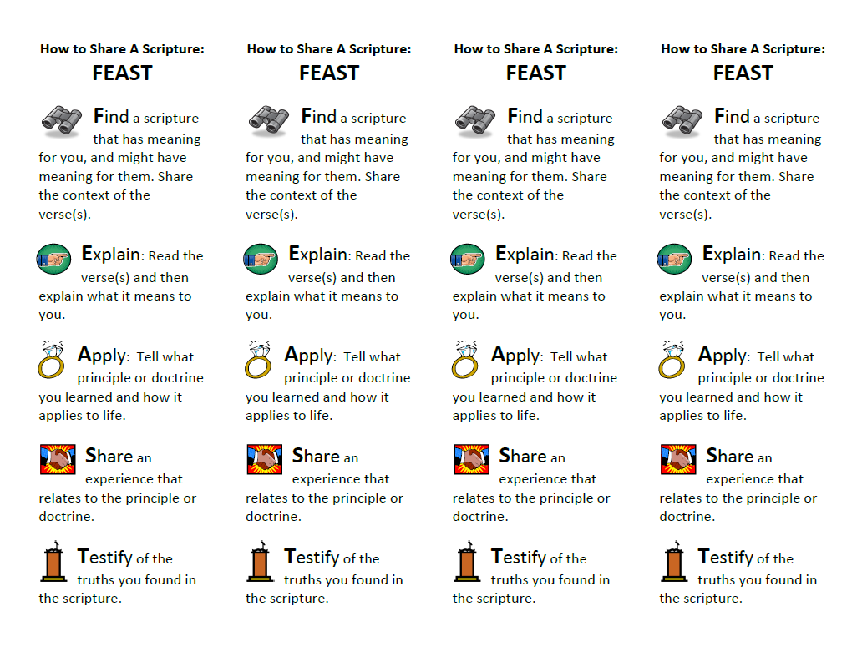
Notes:
Book marks to help them remember how. These can also be given to remind them they have a scriptural through the next day. Have the class VP pass them out the day before they have their thought.

Slide 9
Seminary is a SAFE place
Notes:
I have this up and sometimes have to remind people to be careful how they disagree with others or use sarcasm. In order for the Spirit to be in class, individuals need to feel safe to share their feelings or ideas with out the fear of being attacked or criticized by others. D&C 88:122-124 teaches this very well.

Slide 10
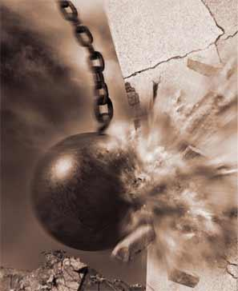




“That all may be edified of all”
-Doctrine & Covenants 88:122
"I passed one day through a lonely town
And saw men tearing a building down
With a ho heave ho and a husky yell
They swung a beam and a side wall fell
I asked the foreman, 'are these men skilled?
The kind you'd hire if you had to build?'
'Oh no', he chuckled 'no indeed.
The common labourer is all I need.
Why I can destroy in a day or two
What builders have taken weeks to do'.
I thought to myself as I went on my way
Which of these roles have I tried to play?
Am I a builder who works with care
Strengthening lives by rule and square
Shaping my peers to a well-made plan
Helping them be the best they can?
Or am I a wrecker who walks around
Content with the labour of tearing down?“
-Author Unknown
Notes:
Same idea as above. The word “edify” in D&C 88:122 literally means “to build” in the Latin. We are to build others up in class, not tear down like people often want to do. It takes not skill to tear down. It does take talent to build others up. Let’s be builders.

Slide 11

The Chinese Character For
“Listening”
Ears
Eyes
One or Single
King
Heart
Notes:
Have your class look at the character. Have them give suggestions why each element is critical to the idea of listening. They will come up with great ideas.

Slide 12
The 4 Aspects of Quality Scripture Marking
Tagging: [Helping the verse(s) stand out so you can find it later.]
Marking Insights: Marking only the keywords in the verses.
Footnote Tags: Marking the ^{Superscript} letter and the significant footnote below.
Annotations: Write down keywords, notes, feelings, and principles in the margins.

Slide 13
“You haven’t read them until you’ve red them.”

Slide 14
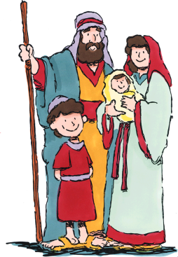
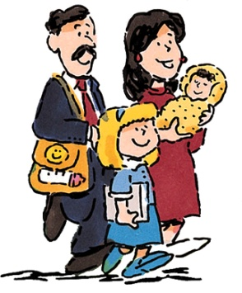
Apply Them
ThemThere Then
Me Here Now
1,000s of Years Ago
21st Century
Get the central meaning of what the verses said
Analyze the verses using questions like “Why” or “How”.
Liken the verses to yourself. Look for a principle or doctrine you can apply.
Notes:
The whole point of Seminary is to learn from the “Them, There, and Then” in the scriptures, and apply the lessons to the “Me, Here, and Now”.

Slide 15
Which Best Describes Your Scripture Study?
Water Skiing
Swimming
Snorkeling
Scuba Diving
Skimming
Reading
Studying
Intense Study
Notes:
Cover up the explanations at the bottom and ask, “What kid of scripture reading is Water Skiing?... Why? And move to the next.

Slide 16
Margin Markers
What’s The Lesson?
(Principle)
Notes:
I like to challenge each class that when they read a page of scripture at night, to then write down in the margin one thing they learned from the page of scripture.

Slide 17


Power Phrases
I really like that verse because…
I think I just had an epiphany…
Stop. I know a great cross reference for that verse…
I have experienced that and want to testify that it is true.
Look, look, I found a principle…
Stop! I know a great Scripture Mastery verse that goes with that…
Hey, there is a General Conference talk about that…
Oh, this reminds me of…
I want to learn more about what is says in that scripture…
OK, I have a question about that…
That makes me feel good because…
That reminds me of when…
Notes:
These are some favorite phrases they can use in class.

Slide 18
When You Study Your Scriptures Look For 4 Colors
The literal meaning. Be able to summarize WHAT you read or put it into your own words.
Black
White
Read between the lines. Analyze. Ask yourself questions about the verse like “WHY?” or “HOW?”
Red
Highlight verses you want to be able to find later. Mark the key parts of verses and footnotes. Mark creatively.
Green
Write in your margin what you learned or what you should GO and do. Write down the lesson, principle, or moral.
Notes:
To get a full explanation of this lesson ideas, go to the website and under “Seminary resources” go to “Scripture Study Skills” lessons.

Slide 19
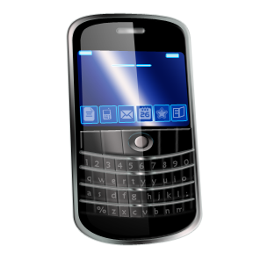

Don’t use Your Cell phone during class
Don’t use Your Cell phone during class
Seminary policy: Any cell phone that is used during class time can be collected by the teacher until after class.
After a second violation, a call home will be made and the suggestion made that the texting feature be disabled from the phone. We only use paper bases scriptures in class.
If you have extenuating circumstances, tell me before class.
Notes:
I don’t know what your stake’s rule is with using cellphones or digital scriptures. Maybe this will help or maybe not.

Slide 20
The Spot
Notes:
This is for putting kids “On The Spot” to share what they learned that day. Kind of like “the Take Away”.

